Slide 1
MPU6050 Gyroscope Accelerometer
Chenyuhang Zhou

Slide 2
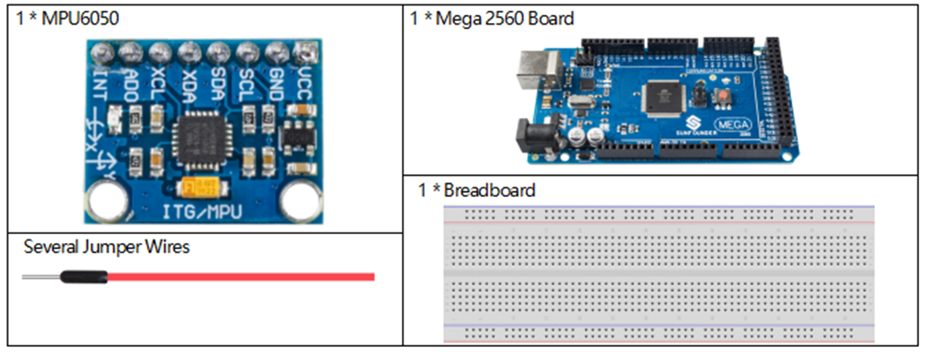
Introduction
The MPU6050 is a compact and versatile motion sensing chip that captures three-axis acceleration and rotational velocity, making it ideal for both industrial applications and hobbyist model aircraft, enabling them to navigate the skies with precision.

Slide 3
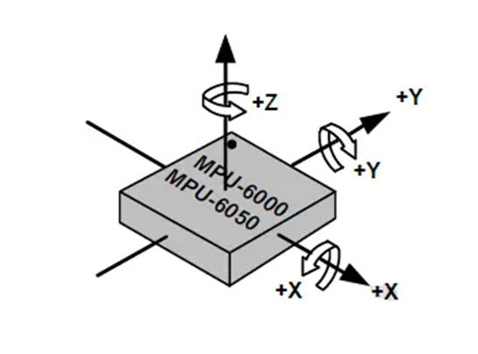
Theory
The MPU6050 is a sensor chip that measures six degrees of freedom: it captures three-dimensional acceleration and rotation rates. It senses linear motion along the X, Y, and Z axes, as well as rotational motion around those axes. This functionality makes it integral for precise movement tracking in various technologies, including robotics and flight controls.

Slide 4
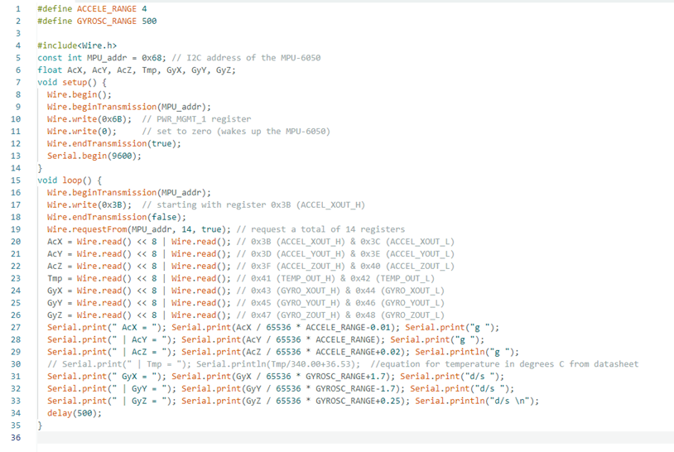
coding
Basic programming downloaded from the website

Slide 5
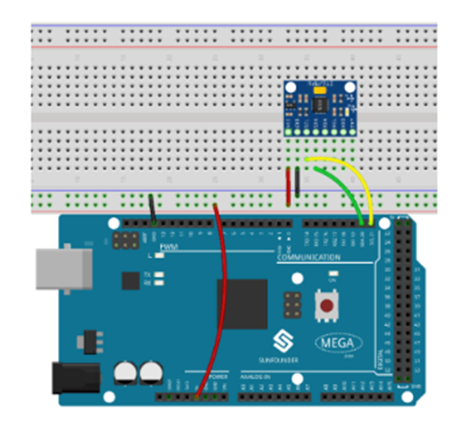
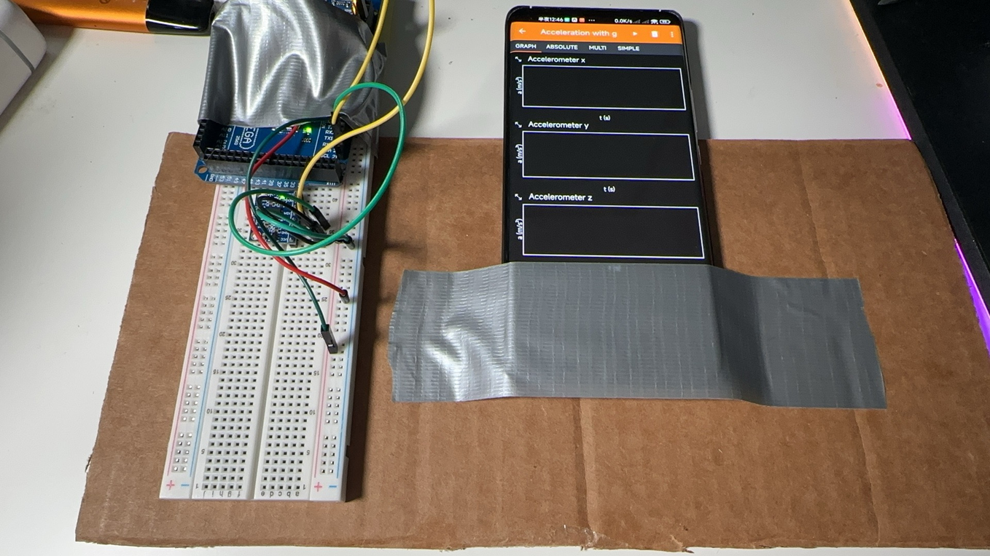
Wiring
I took the smartphone and our required MPU6050 and bundled it on the same cardboard to ensure the same variables.

Slide 6
Measurement purpose
Specification of MPU6050
Chip built-in 16bit AD converter, 16-bit data output
Driver Chip: MPU6050
Operating Voltage: 3-5V DC
Communication: I2C/IIC Protocol
Gyro Range: ± 250, 500, 1000, 2000 °/s
Accelerometer Range: ± 2 ± 4 ± 8 ± 16 g
1. Sensitivity and Range
2. Accuracy and Error
3. Drift

Slide 7
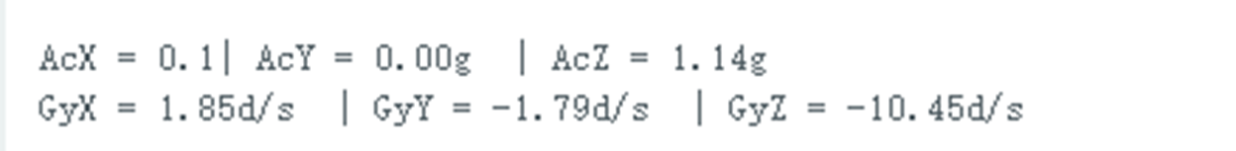
Sensitivity and Range
Objective: Determine the sensor's ability to detect minimal movements and its maximum measurable limits.
Method: Use a smartphone with a built-in gyroscope and accelerometer as a reference. Most smartphones have high-precision sensors, and various apps can log sensor data I choose phyphox as the Accelerometer.
Equipment: MPU6050 module, smartphone, Arduino or similar microcontroller, breadboard, and jumper wires.
Procedure: Secure both the MPU6050 and the smartphone on a flat, stable surface. Use an app to record the smartphone's sensor data while simultaneously logging data from the MPU6050 as you gently tilt the surface to introduce slight movements. Compare the two data sets to evaluate sensitivity and range.
Data measured at rest

Slide 8

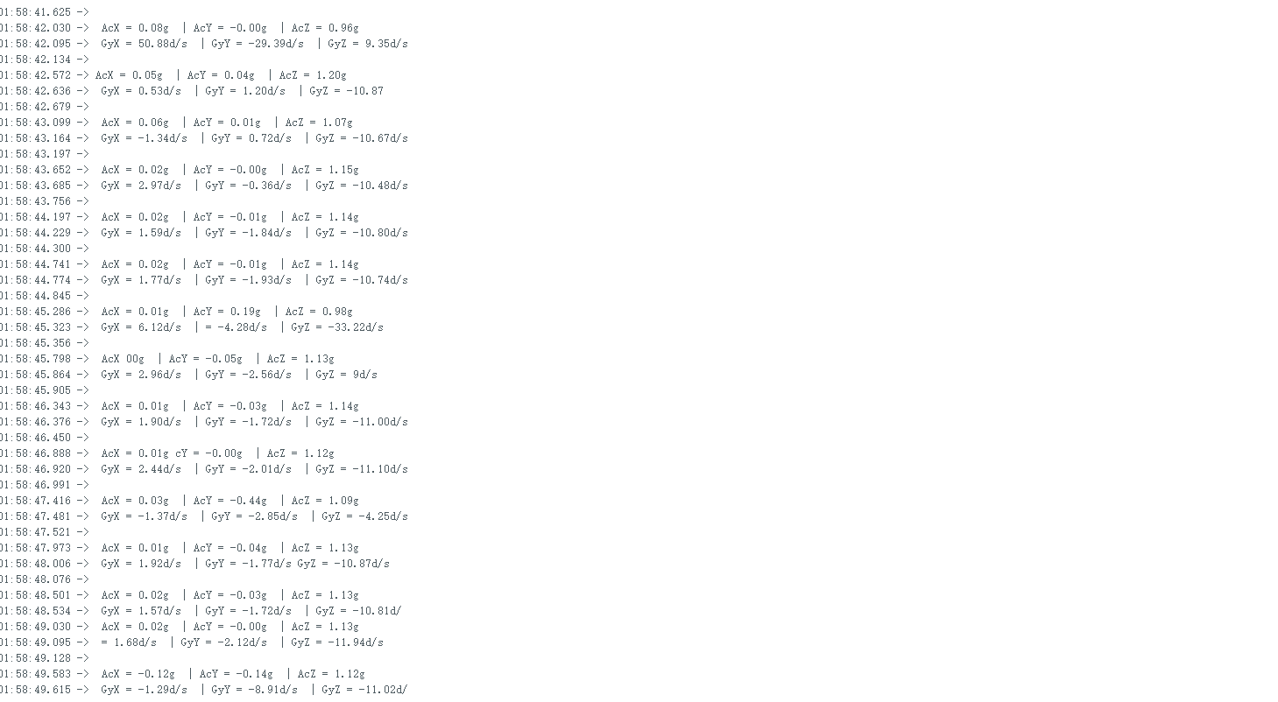
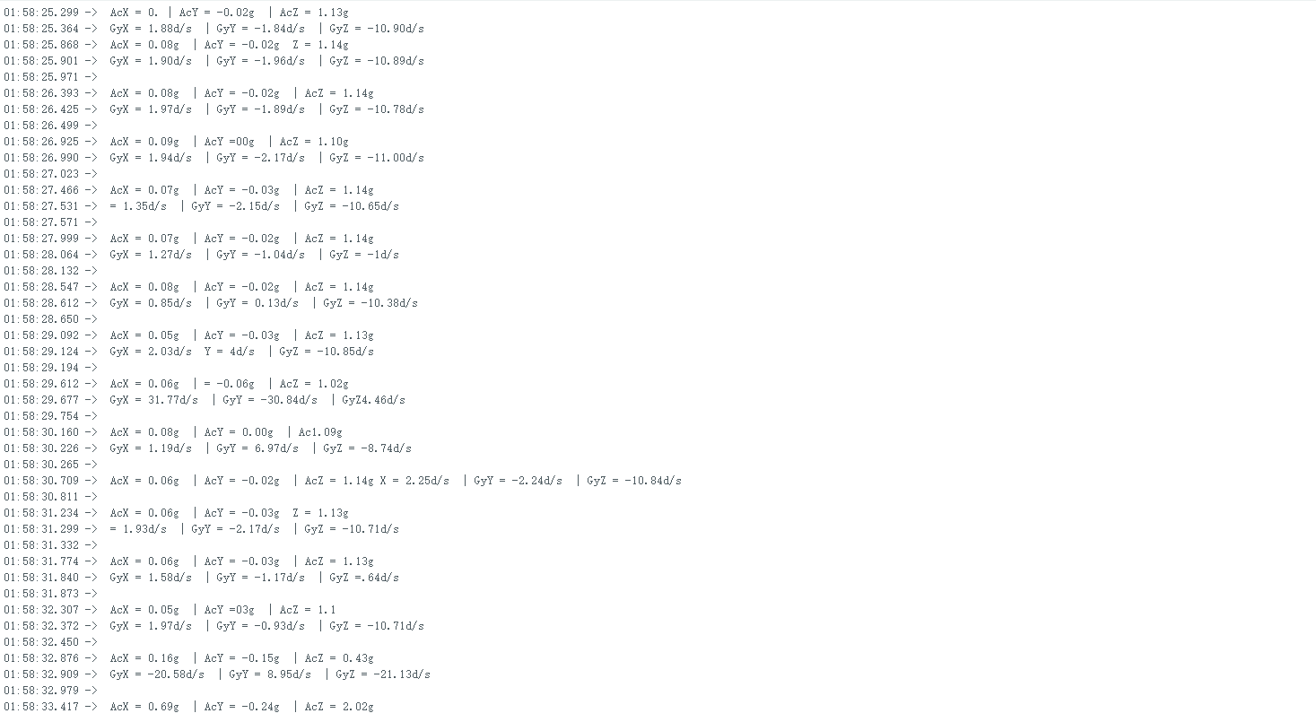
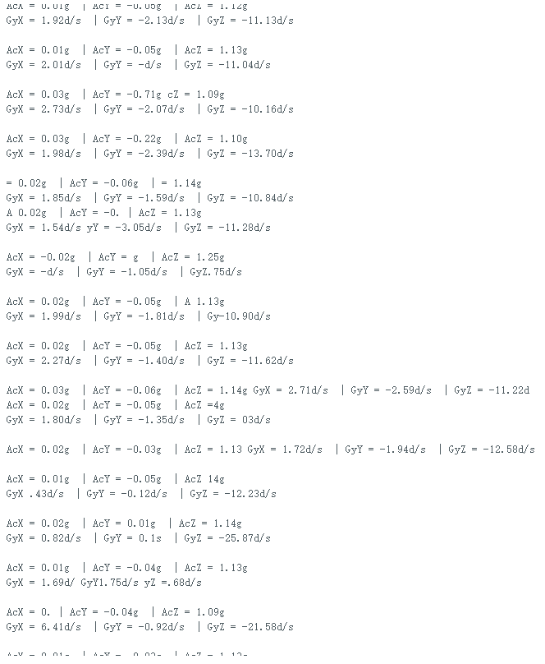
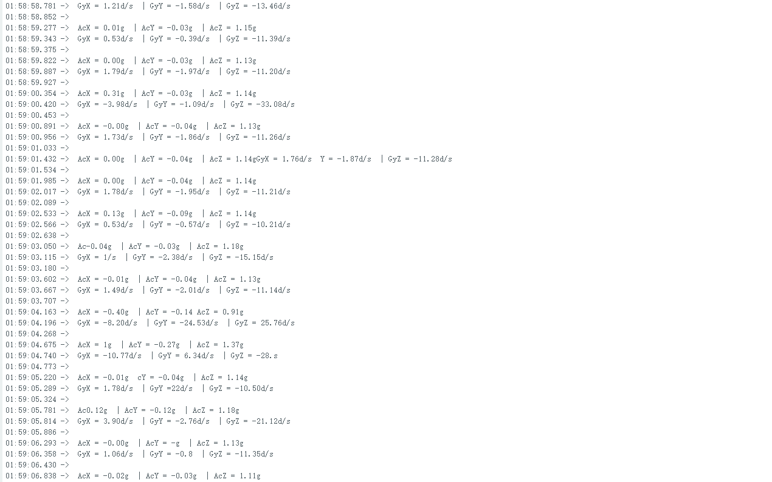
Date from sensor

Slide 9
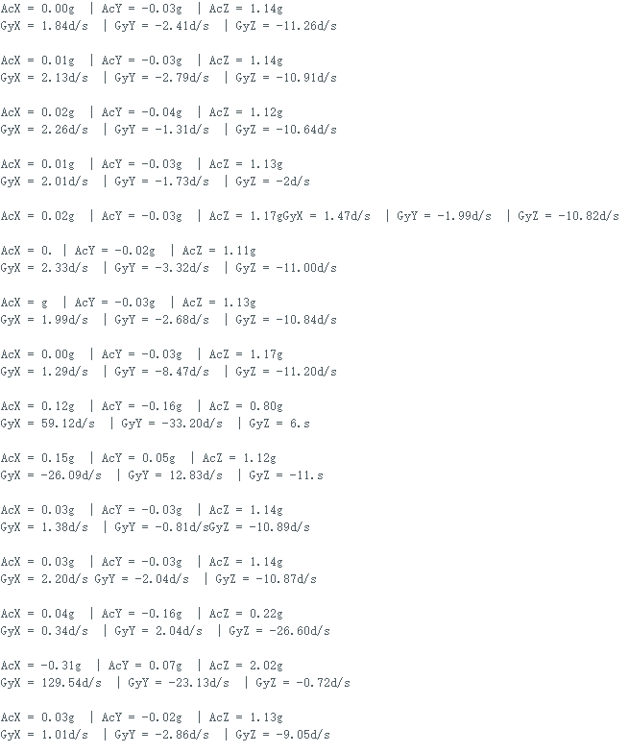
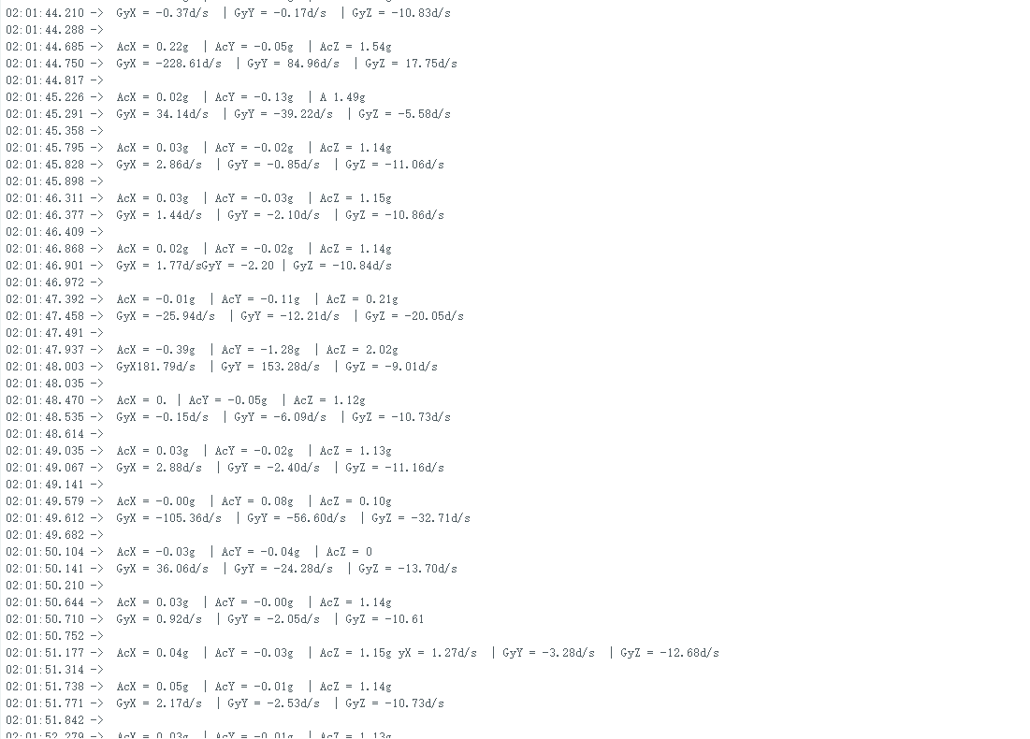
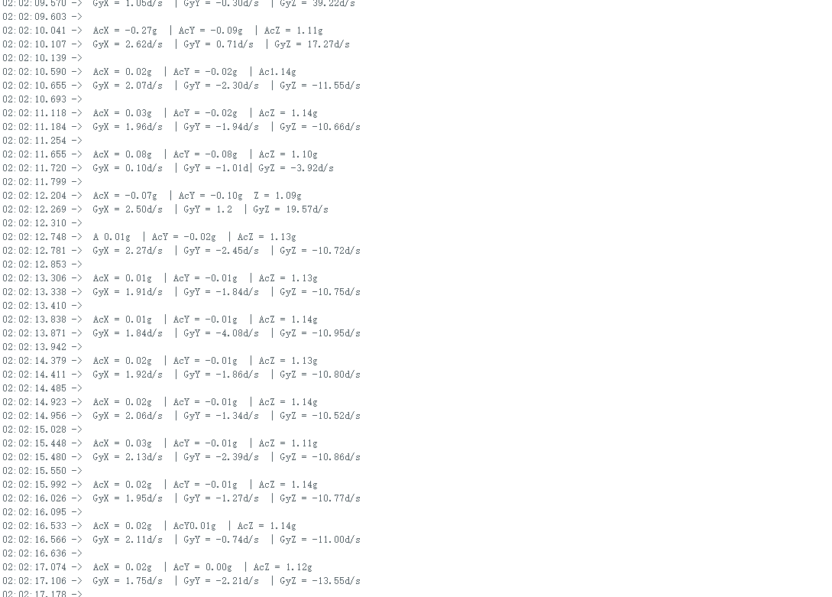

Slide 10
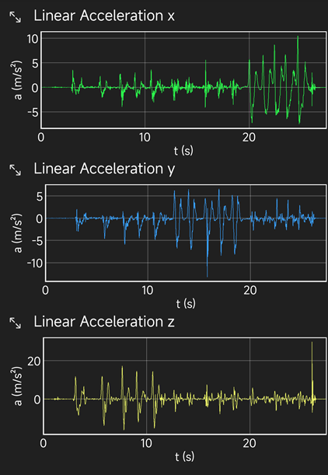
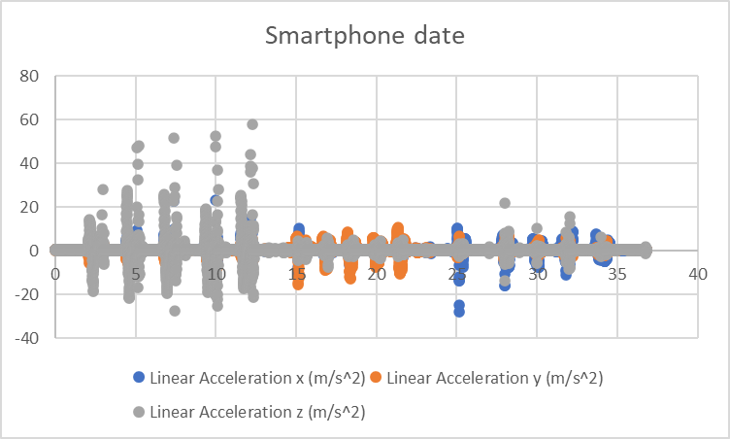

Slide 11
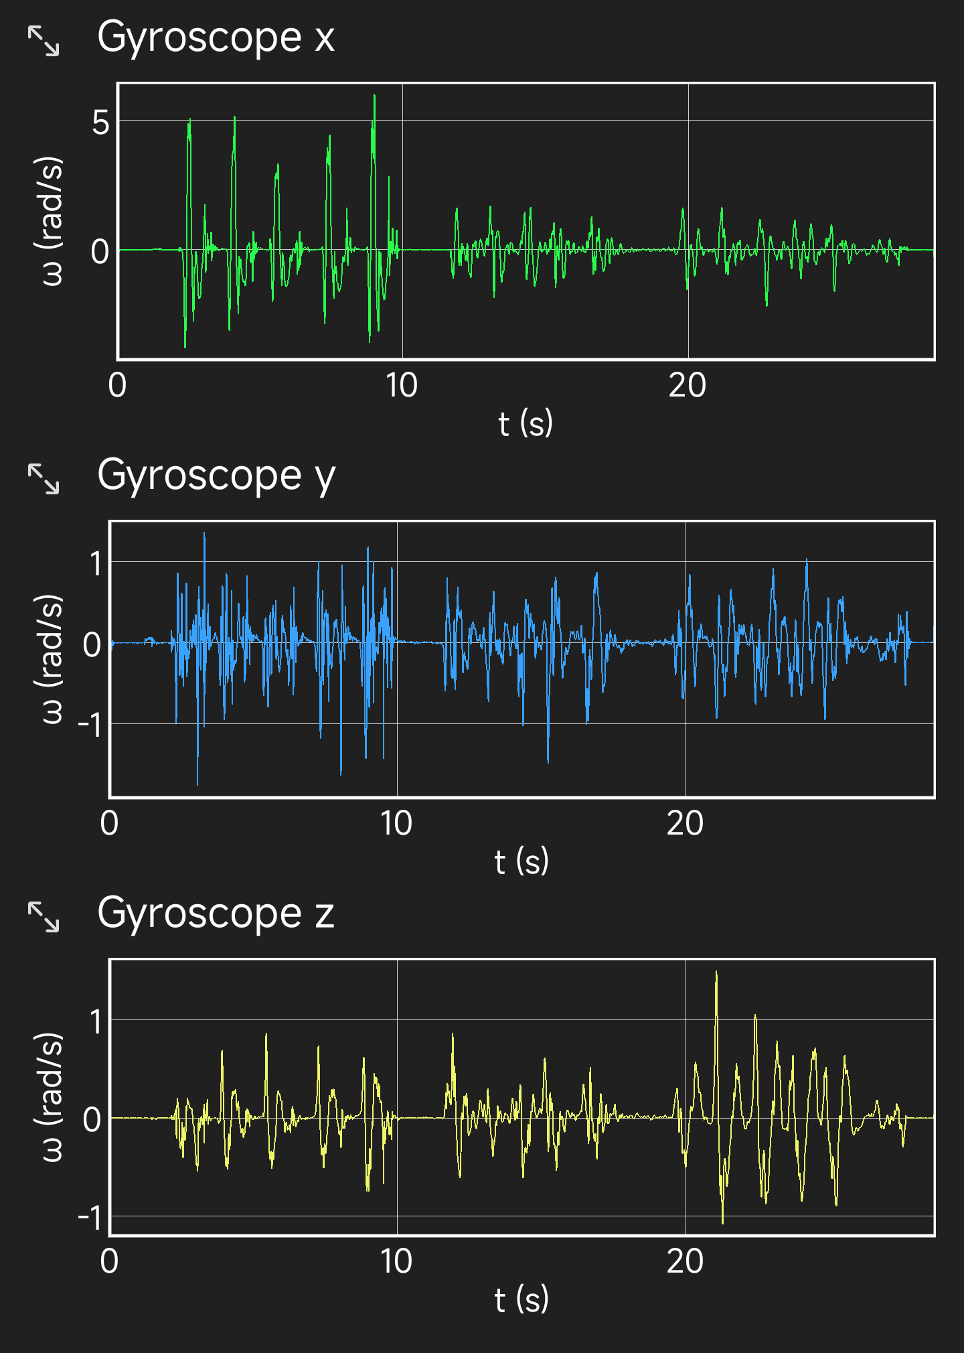
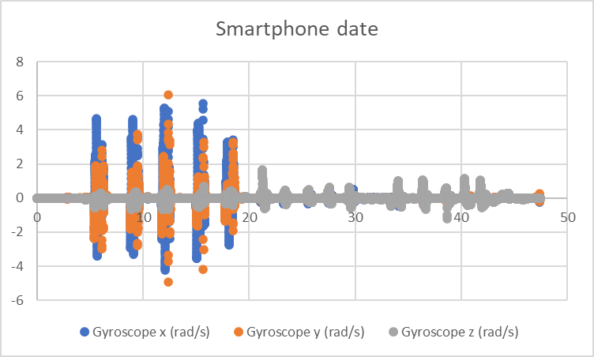

Slide 12
CONCLUSION
According to the comparative data, in terms of acceleration, the sensor can change within the characteristic range and measure some peak data, but the data feedback is not as sensitive as the linear one used in mobile phone applications, while the feedback on angular velocity is faster and the measured data is also more sensitive. many. But there is still no linearity to the data shown.

Slide 13
Accuracy and Error
Objective: Compare sensor measurements to known standards to determine accuracy and error range.
Method: Conduct three free falls at the same height and compare the data obtained by the mobile app phyphox with the sensor data.
Equipment: MPU6050, arduino mega, smartphone breadboard.
Steps: Fix the MPU6050 and smartphone on a stable, horizontal surface. Three free falls were made from the same height (10cm) and the readings from the MPU6050 were compared to those from the phyphox. Calculate the average error and accuracy of sensor readings.

Slide 14
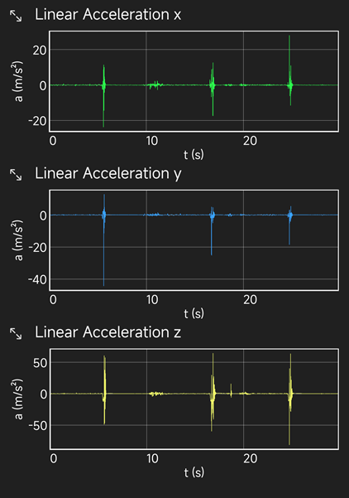
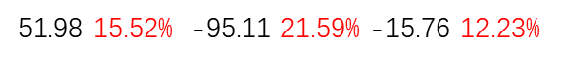

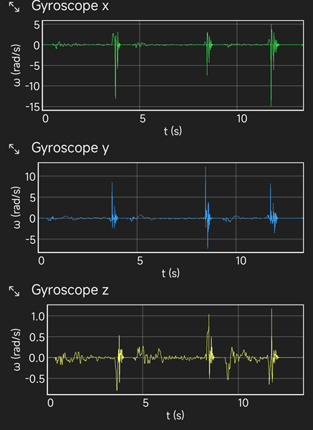
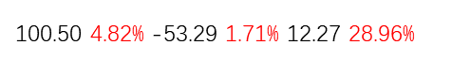
DATE FROM SENSOR
DATE FROM APP

Slide 15
CONCLUSION
From the three data feedback analysis, the sensor well records the changes in physical quantities at all times. At the same time, the difference in error is not large.

Slide 16
Drift
Objective: Assess how much the sensor's measurements vary over time without any external movement.
Method: Long-term stationary observation.
Equipment: MPU6050, microcontroller, data logging software or setup.
Procedure: Set up the MPU6050 in a stationary position without any movement for an extended period (e.g., 24 hours). Log the sensor output continuously. Analyze the data for variations that would indicate drift.

Slide 17
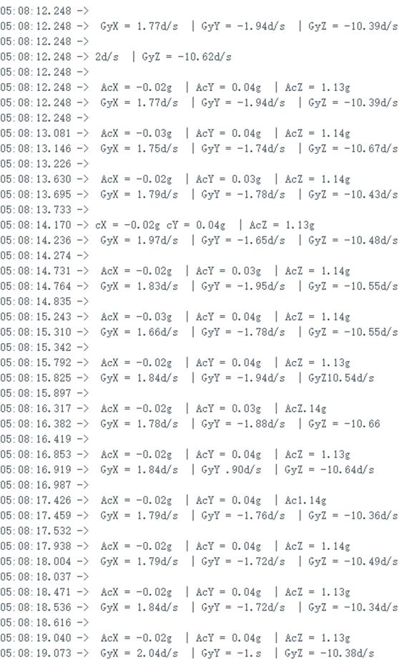
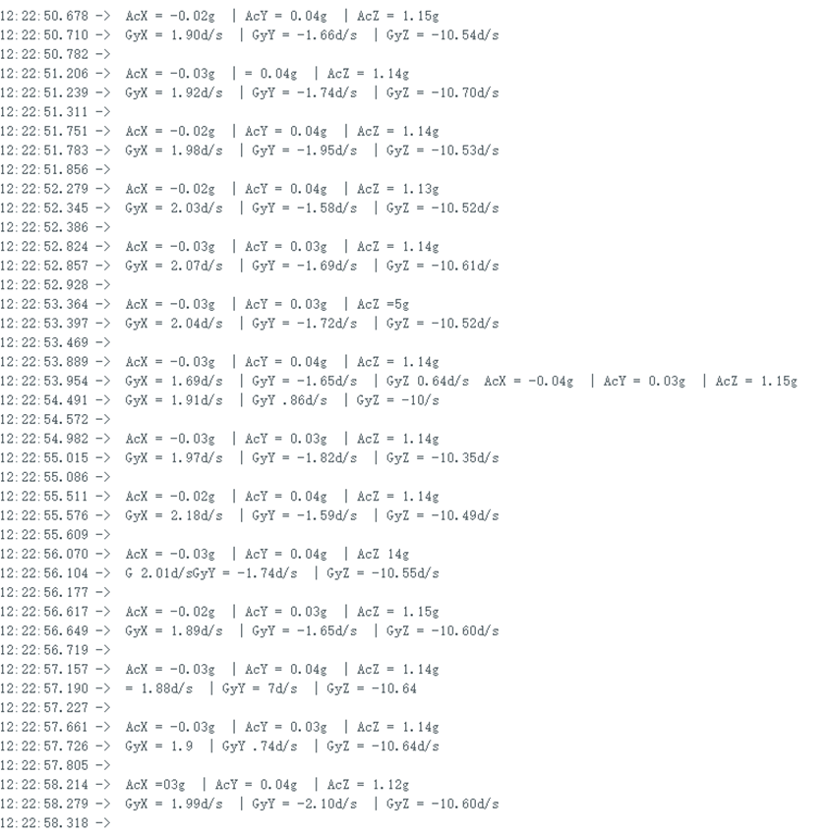
7 hours drift

Slide 18
Summary
In summary, MPU6050 is a highly integrated and easy-to-use sensor. Two types of data and three directions can allow us to obtain a lot of information. Simple wiring makes it easy to control during the measurement process. However, the error of the sensor, the interval of data sampling, and the maximum measurement range still need to be considered in actual use. At the application level, we should further establish molds to fix the board and sensor to eliminate errors.

